Slide 1
DATA 300
Topic 6: Variable selection

Slide 2
Agenda
Why variable selection?
Naïve approach
an example on linear regression
different ways to determine the optimal model
Complex approach
Ridge
Lasso

Slide 3

Bias-variance trade-off
MSE can be decomposed to
Bias tends to be low as we have more predictors.
Variance tends to be low as we have less predictors.
In other words, when bias is already small enough, having less predictors might be able to reduce variance A LOT without hurting bias too much.

Slide 4
Naïve approach
The naïve approach is to build multiple models, using different numbers of predictors, and see which one works the best.
“Best” in terms of what?

Slide 5
Naïve approach
The naïve approach is to build multiple models, using different numbers of predictors, and see which one works the best.
The key here is to determine what is ”best”. It could be smaller Mean Absolute Error for linear regression, could be better accuracy for classification models, could be having a specific number of significant predictors for generalized linear models.

Slide 6
Variable selection in Regression models
This naïve approach is long used in regression models. It has multiple formats:
Best subset selection
Stepwise selection
Backward selection
Forward selection
Hybrid

Slide 7
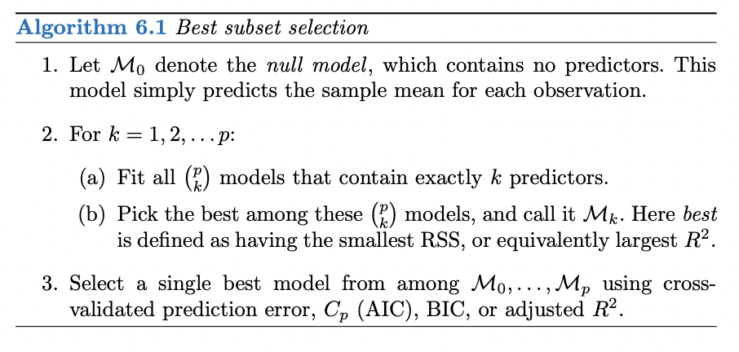
Best subset selection

Slide 8
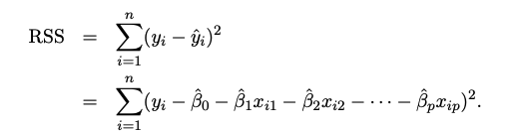
Objective function for linear regression
Therefore, the objective for a linear regression model becomes minimize residuals.
Specifically, it is to minimize the sum of squared residuals (RSS), this is called the Ordinary Least Squared (OLS) Method.

Slide 9

Variable selection: forward selection
Step 0: start with a null model, a model that contains no predictors.
Step 1: For each of the D predictors, run a simple linear regression
$y={ b}_{0}+{ b}_{j}{ x}_{j}$,
Find the regression with the lowest RSS.

Slide 10
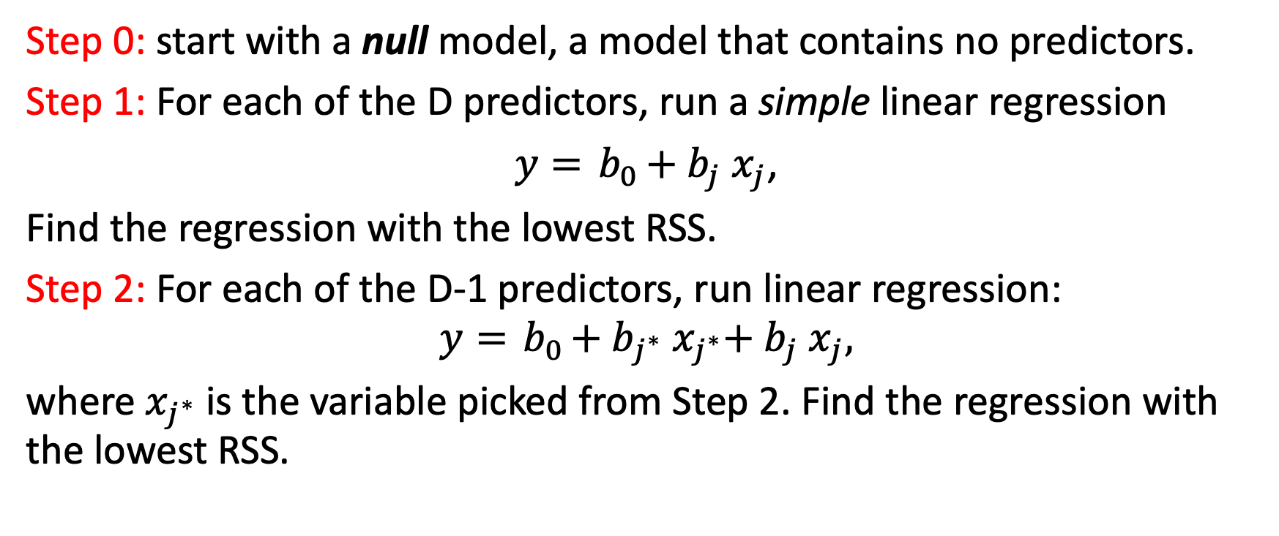
Variable selection: forward selection
Step 0: start with a null model, a model that contains no predictors.
Step 1: For each of the D predictors, run a simple linear regression
$y={ b}_{0}+{ b}_{j}{ x}_{j}$,
Find the regression with the lowest RSS.
Step 2: For each of the D-1 predictors, run linear regression:
$$y={ b}_{0}+{ b}_{j^{∗}}{ x}_{j^{∗}}+{ b}_{j}{ x}_{j},$$
where $x_{j^{∗}}$ is the variable picked from Step 2. Find the regression with the lowest RSS.

Slide 11
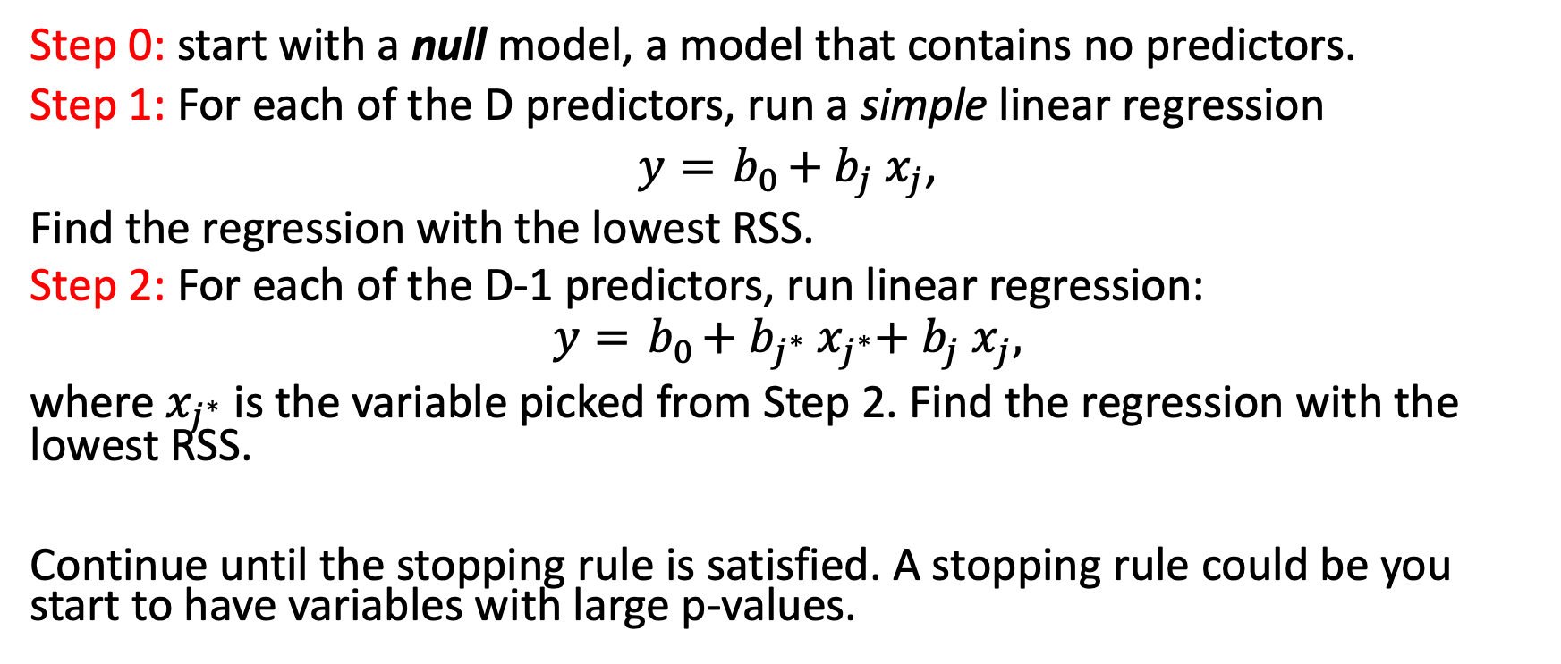
Variable selection: forward selection
Step 0: start with a null model, a model that contains no predictors.
Step 1: For each of the D predictors, run a simple linear regression
$y={ b}_{0}+{ b}_{j}{ x}_{j}$,
Find the regression with the lowest RSS.
Step 2: For each of the D-1 predictors, run linear regression:
$$y={ b}_{0}+{ b}_{j^{∗}}{ x}_{j^{∗}}+{ b}_{j}{ x}_{j},$$
where $x_{j^{∗}}$ is the variable picked from Step 2. Find the regression with the lowest RSS.
Continue until the stopping rule is satisfied. A stopping rule could be you start to have variables with large p-values.

Slide 12
Variable selection: backward selection
Step 0: start with a full model, a model that contains all the predictors.
Step 1: Remove the variable with the largest p-value.

Slide 13
Variable selection: backward selection
Step 0: start with a full model, a model that contains all the predictors.
Step 1: Remove the variable with the largest p-value.
Step 2: Run a linear regression with the rest of the D-1 variables. Remove the variable with the largest p-value.
Continue until a stopping rule is reached. For example, we can stop if the model only contains significant variables.

Slide 14
Quick question:
Think about if forward would be better or backward for each of the following scenarios:
We have 1,000,000 variables available, but only try to keep 10.
We have 1,000,000 variables available, but only try to keep 900,000.
We have 10 variables.

Slide 15
In R
All the naïve selection methods (best subset, forward, backward) requires a user-defined stopping rule. The easiest one to implement in R is to minimize the Akaike information criterion (AIC).
In short, AIC is an estimator of the prediction error.
Use the lm() function to build a null model and a full model.
Use the stepAIC function to do forward or backward selection.

Slide 16
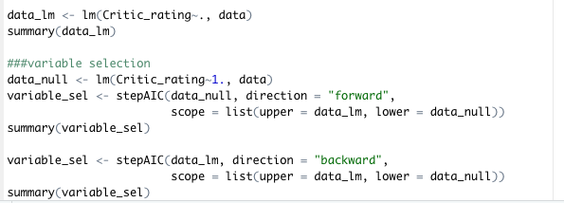
In R
Full model
null model
Starting from null model for forward selection
Starting from full model for backward selection

Slide 17
Agenda
Why variable selection?
Naïve approach
an example on linear regression
different ways to determine the optimal model
Complex approach
Ridge
Lasso

Slide 18
In R
All the naïve selection methods (best subset, forward, backward) requires a user-defined stopping rule. The easiest one to implement in R is to minimize the Akaike information criterion (AIC).
What is AIC?
What are the other approaches?

Slide 19
Choosing the optimal combination of predictors
Which one (or more) would be a bad measure(s) to decide the optimal model with the optimal combination of variables?
Training error
Validation error
R-squared

Slide 20
Choosing the optimal combination of predictors
Which one (or more) would be a bad measure(s) to decide the optimal model with the optimal combination of variables?
Training error, because training error tends to decrease as the # of variables increase. By nature, training error is against the goal of reducing the # of variables.
Validation error
R-squared, same idea

Slide 21
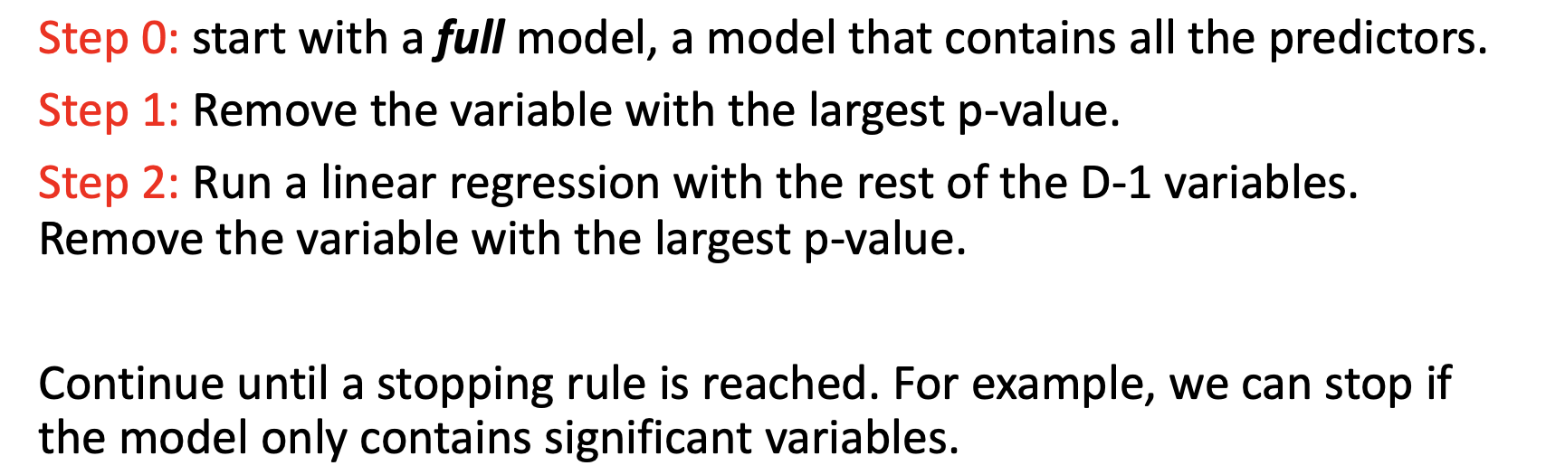
Choosing the optimal combination of predictors: using validation error in the naïve approach
Validation error from validation set
For example, in backward selection:
For each linear regression model built, document the validation error on the validation set. Stop the process when the validation error stopped decreasing.

Slide 22
Choosing the optimal combination of predictors: using validation error in the naïve approach
Validation error from the validation set approach
Validation error from cross-validation
Similar idea, if we decide to do cross-validation, then for each linear regression model built, document the cross-validation error. Stop the process when the cross-validation error stopped decreasing.

Slide 23
Choosing the optimal combination of predictors: adjustments based on training errors
We can’t use training error/R-squared to decide the optimal combination of predictors, because chances are training error/R-squared reaches optimal when we have ALL predictors.

Slide 24
Choosing the optimal combination of predictors: adjustments based on training errors
We can’t use training error/R-squared to decide the optimal combination of predictors, because chances are training error/R-squared reaches optimal when we have ALL predictors.
In response, we could, e.g., adjust the formula for R-squared, so that it factors in the number of predictors.

Slide 25
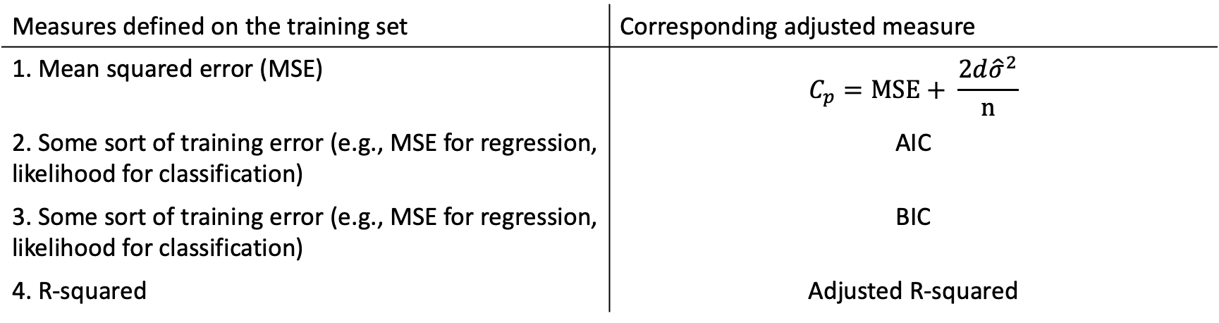
Choosing the optimal combination of predictors: common training-error based measures
Measures defined on the training set | Corresponding adjusted measure
1. Mean squared error (MSE) | $$C_{p}=MSE+ \frac{2d{\hat{σ}}^{2}}{n}$$
2. Some sort of training error (e.g., MSE for regression, likelihood for classification) | AIC
3. Some sort of training error (e.g., MSE for regression, likelihood for classification) | BIC
4. R-squared | Adjusted R-squared

Slide 26
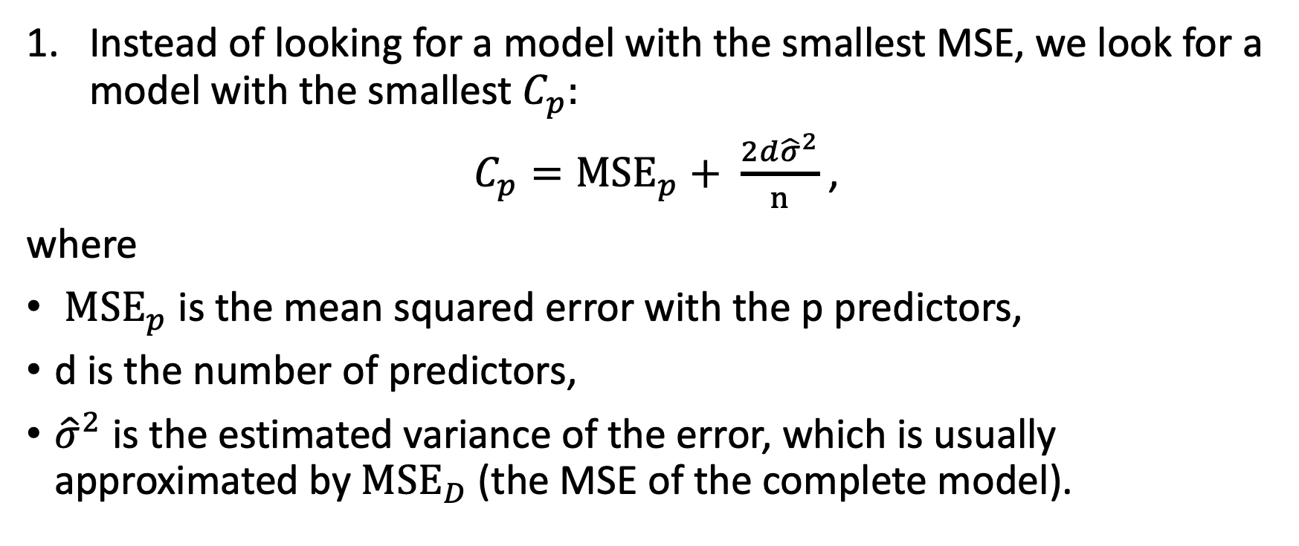
Choosing the optimal combination of predictors: common training-error based measures
Instead of looking for a model with the smallest MSE, we look for a model with the smallest $C_{p}:$
$C_{p}={MSE}_{p}+ \frac{2d{\hat{σ}}^{2}}{n}$ ,
where
${MSE}_{p}$ is the mean squared error with the p predictors,
d is the number of predictors,
${\hat{σ}}^{2}$ is the estimated variance of the error, which is usually approximated by ${MSE}_{D}$(the MSE of the complete model).

Slide 27
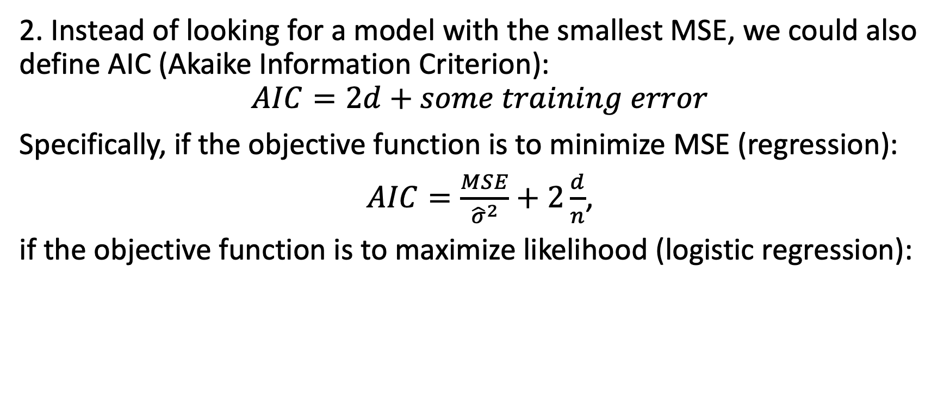
Choosing the optimal combination of predictors: common training-error based measures
2. Instead of looking for a model with the smallest MSE, we could also define AIC (Akaike Information Criterion):
$$AIC=2d+some training error$$
Specifically, if the objective function is to minimize MSE (regression):
$AIC=\frac{MSE}{{\hat{σ}}^{2}}+2\frac{d}{n}$,
if the objective function is to maximize likelihood (logistic regression):

Slide 28
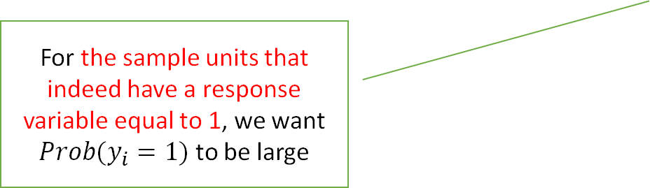

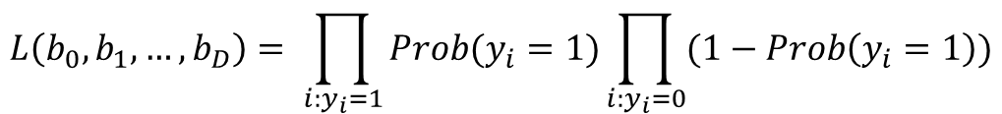
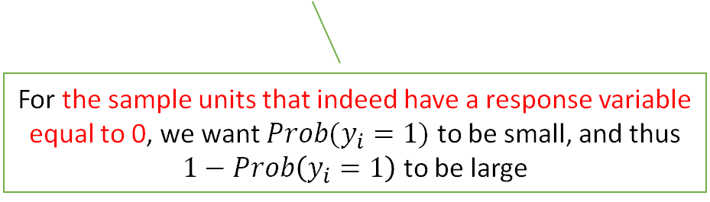
Review: objective function of logistic regression
Therefore, in logistic regression, the goal is to find a parameter set that maximizes:
This is called Maximize Likelihood Estimation (MLE), the objective function $L\left(b_{0},b_{1}, …,b_{D}\right)$ is called the likelihood function.
MLE is one of the most common approaches to fit non-linear models. However, it often does not have an analytical solution.
$$L\left(b_{0},b_{1}, …,b_{D}\right)= \prod_{i:y_{i}=1}^{ }{Prob(y_{i}=1)}\prod_{i:y_{i}=0}^{ }{(1−Prob\left(y_{i}=1\right))}$$
For the sample units that indeed have a response variable equal to 1, we want $Prob(y_{i}=1)$ to be large
For the sample units that indeed have a response variable equal to 0, we want $Prob(y_{i}=1)$ to be small, and thus
$1−Prob\left(y_{i}=1\right)$ to be large

Slide 29
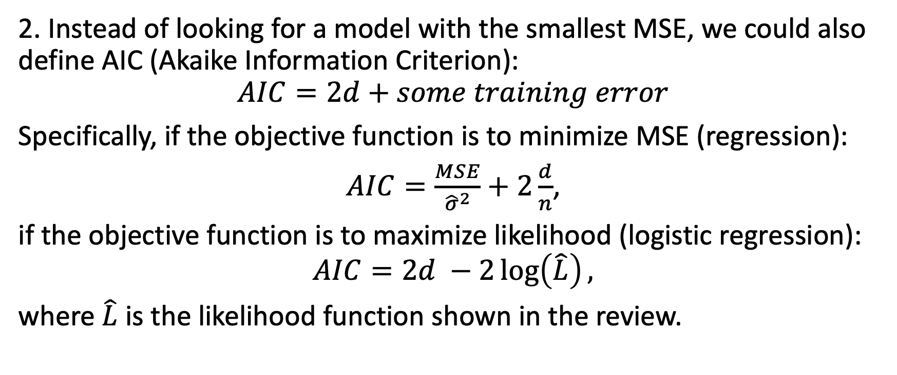
Choosing the optimal combination of predictors: common training-error based measures
2. Instead of looking for a model with the smallest MSE, we could also define AIC (Akaike Information Criterion):
$$AIC=2d+some training error$$
Specifically, if the objective function is to minimize MSE (regression):
$AIC=\frac{MSE}{{\hat{σ}}^{2}}+2\frac{d}{n}$,
if the objective function is to maximize likelihood (logistic regression):
$$AIC=2d −2\log\left(\hat{L}\right),$$
where $\hat{L}$ is the likelihood function shown in the review.

Slide 30
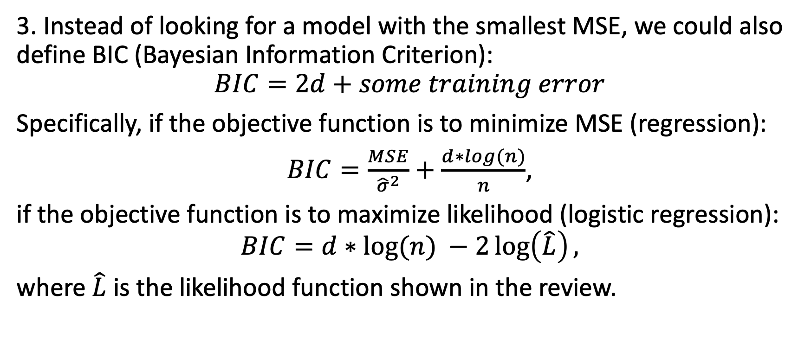
Choosing the optimal combination of predictors: common training-error based measures
3. Instead of looking for a model with the smallest MSE, we could also define BIC (Bayesian Information Criterion):
$$BIC=2d+some training error$$
Specifically, if the objective function is to minimize MSE (regression):
$BIC=\frac{MSE}{{\hat{σ}}^{2}}+\frac{d∗log(n)}{n}$,
if the objective function is to maximize likelihood (logistic regression):
$$BIC=d∗log⁡(n) −2\log\left(\hat{L}\right),$$
where $\hat{L}$ is the likelihood function shown in the review.

Slide 31
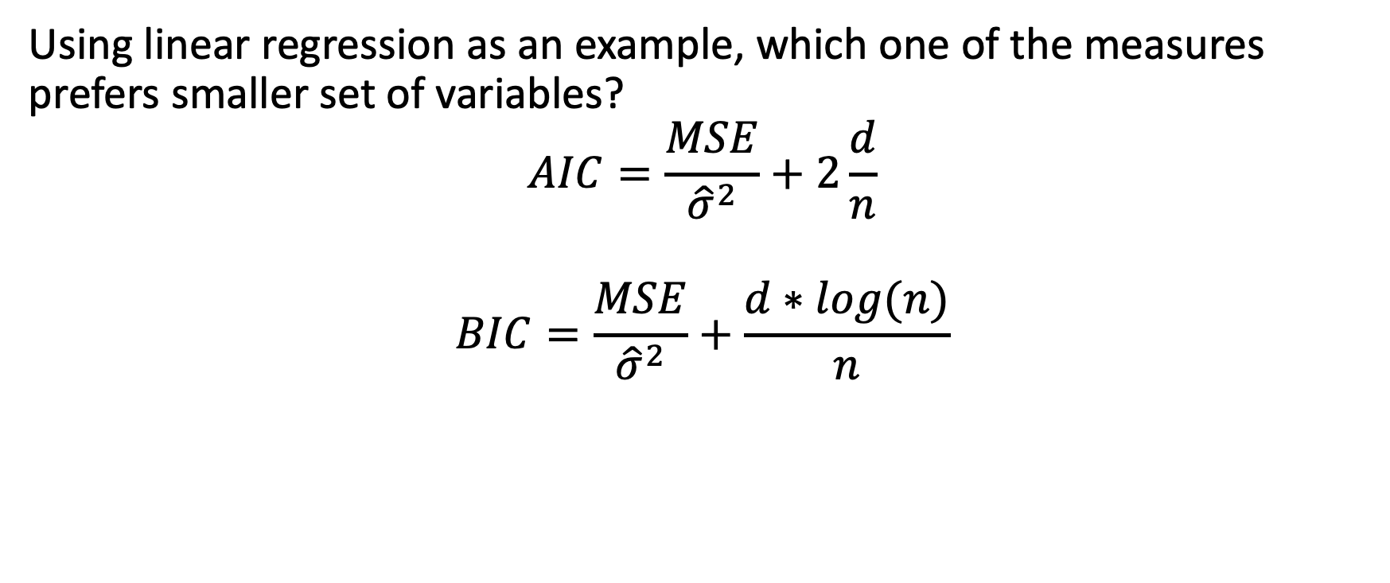
Quick math checking:
Using linear regression as an example, which one of the measures prefers smaller set of variables?
$$AIC=\frac{MSE}{{\hat{σ}}^{2}}+2\frac{d}{n}$$
$$BIC=\frac{MSE}{{\hat{σ}}^{2}}+\frac{d∗log(n)}{n}$$

Slide 32
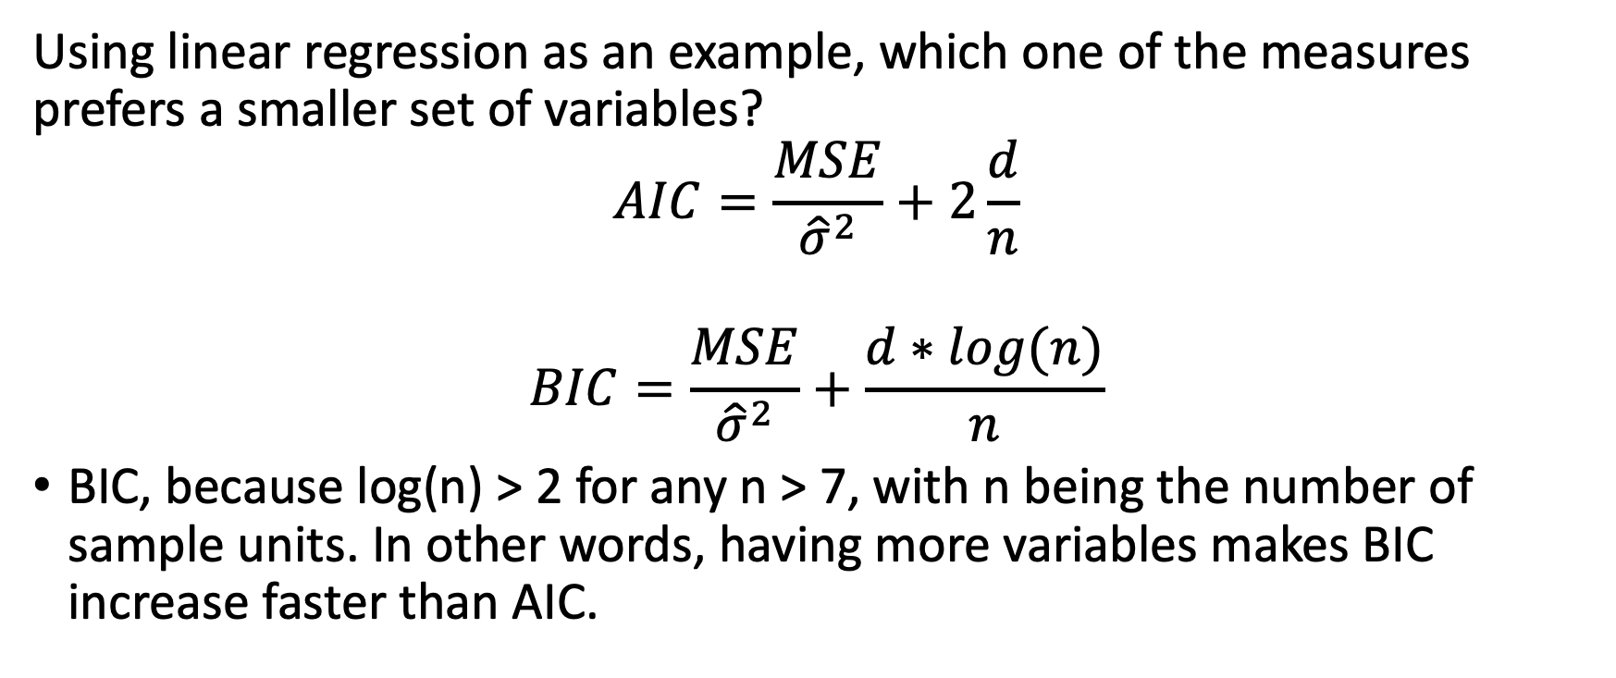
Quick math checking:
Using linear regression as an example, which one of the measures prefers a smaller set of variables?
$$AIC=\frac{MSE}{{\hat{σ}}^{2}}+2\frac{d}{n}$$
$$BIC=\frac{MSE}{{\hat{σ}}^{2}}+\frac{d∗log(n)}{n}$$
BIC, because log(n) > 2 for any n > 7, with n being the number of sample units. In other words, having more variables makes BIC increase faster than AIC.

Slide 33
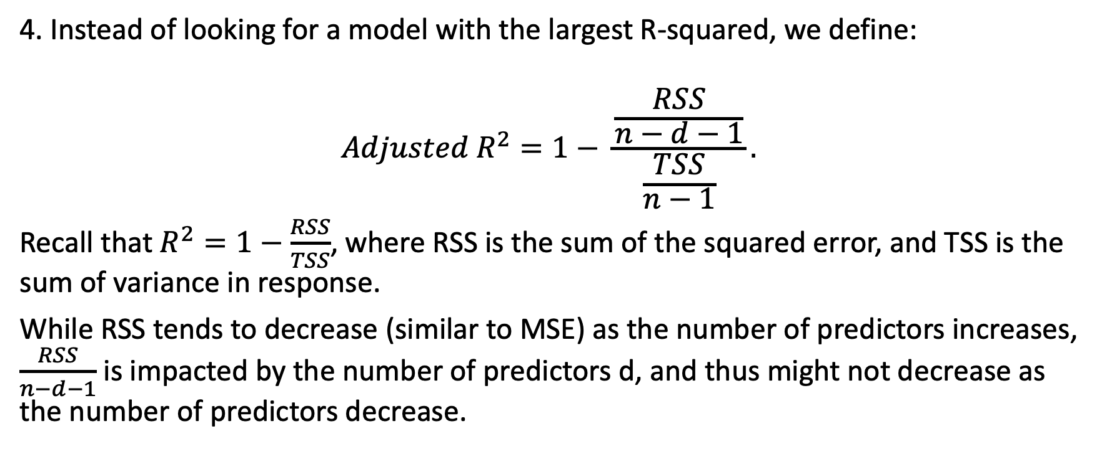
Choosing the optimal combination of predictors: common training-error based measures
4. Instead of looking for a model with the largest R-squared, we define:
$$Adjusted R^{2}=1− \frac{\frac{RSS}{n−d−1}}{\frac{TSS}{n−1}}.$$
Recall that $R^{2}=1−\frac{RSS}{TSS}$, where RSS is the sum of the squared error, and TSS is the sum of variance in response.
While RSS tends to decrease (similar to MSE) as the number of predictors increases, $\frac{RSS}{n−d−1}$is impacted by the number of predictors d, and thus might not decrease as the number of predictors decrease.

Slide 34
Choosing the optimal combination of predictors: common training-error based measures
Measures defined on the training set | Corresponding adjusted measure
1. Mean squared error (MSE) | $$C_{p}=MSE+ \frac{2d{\hat{σ}}^{2}}{n}$$
2. Some sort of training error (e.g., MSE for regression, likelihood for classification) | AIC
3. Some sort of training error (e.g., MSE for regression, likelihood for classification) | BIC
4. R-squared | Adjusted R-squared

Slide 35
To recap
The easiest way to decide on the best combination of predictors is to try different combinations. In a linear regression setting, they are called best subset selection, forward selection, backward selection, etc.
All the naïve selection methods (best subset, forward, backward) requires a user-defined stopping rule. The easiest one to implement in R is to minimize the Akaike information criterion (AIC).
In short, AIC is an estimator of the prediction error.
Use the lm() function to build a null model and a full model.
Use the stepAIC function to do forward or backward selection.

Slide 36
To recap
The easiest way to decide on the best combination of predictors is to try different combinations. In a linear regression setting, they are called best subset selection, forward selection, backward selection, etc.
All the naïve selection methods (best subset, forward, backward) requires a user-defined stopping rule. In other words, we can stop searching when we have a good enough
validation error, or
an adjusted training error
C_{p}, AIC, BIC, Adjusted R-squared

Slide 37
Agenda
Why variable selection?
Naïve approach
an example on linear regression
different ways to determine the optimal model
Complex approach
Ridge
Lasso

Slide 38
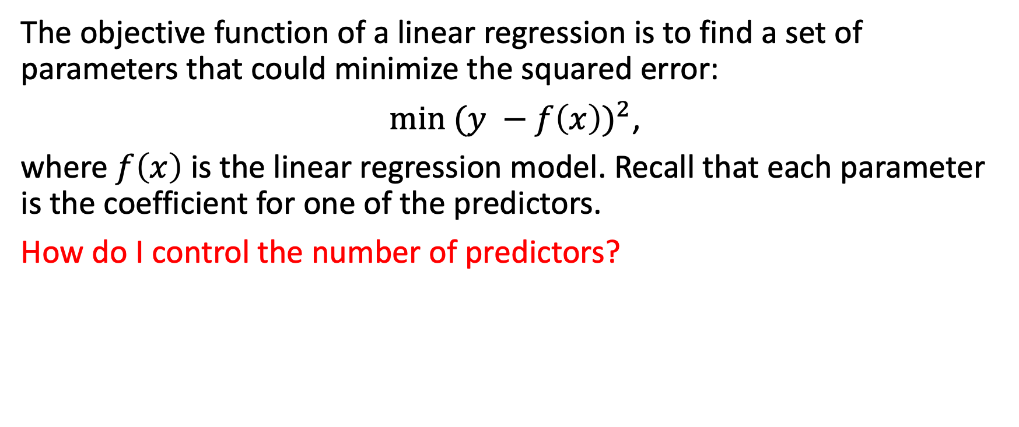
Shrinkage methods
The objective function of a linear regression is to find a set of parameters that could minimize the squared error:
$\min{{(y −f\left(x\right))}^{2}}$,
where $f\left(x\right)$ is the linear regression model. Recall that each parameter is the coefficient for one of the predictors.
How do I control the number of predictors?

Slide 39
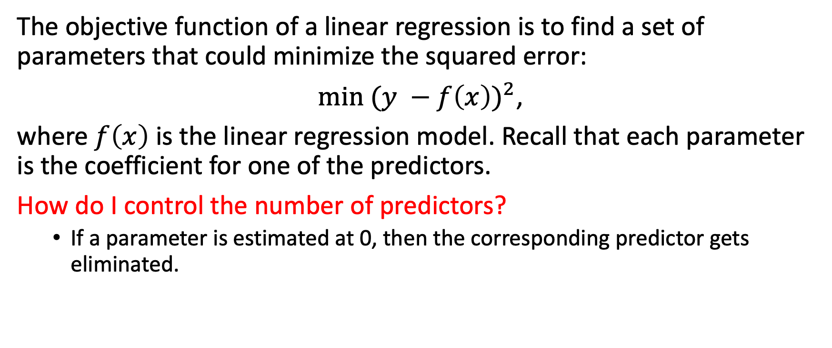
Shrinkage methods
The objective function of a linear regression is to find a set of parameters that could minimize the squared error:
$\min{{(y −f\left(x\right))}^{2}}$,
where $f\left(x\right)$ is the linear regression model. Recall that each parameter is the coefficient for one of the predictors.
How do I control the number of predictors?
If a parameter is estimated at 0, then the corresponding predictor gets eliminated.

Slide 40
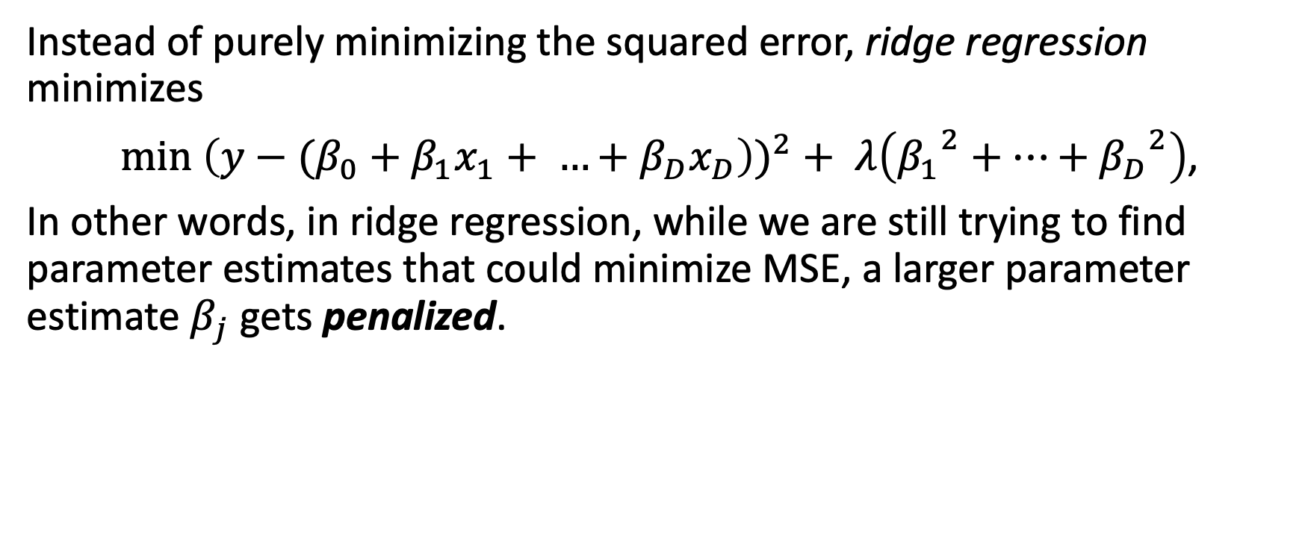
Shrinkage methods: ridge regression
Instead of purely minimizing the squared error, ridge regression minimizes
$\min{{\left(y−{(β_{0}+β}_{1}x_{1}+ …+β_{D}x_{D}\right))}^{2}+ λ\left({β_{1}}^{2}+…+{β_{D}}^{2}\right)}$,
In other words, in ridge regression, while we are still trying to find parameter estimates that could minimize MSE, a larger parameter estimate $β_{j}$ gets penalized.

Slide 41
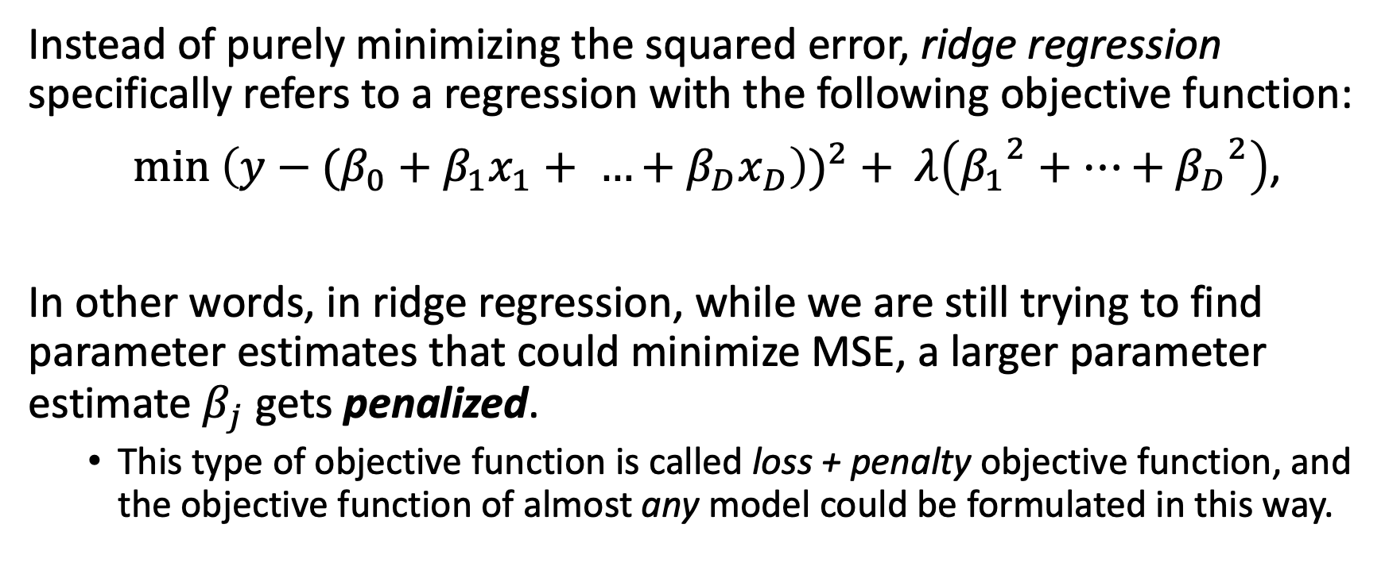
Shrinkage methods: ridge regression
Instead of purely minimizing the squared error, ridge regression specifically refers to a regression with the following objective function:
$\min{{\left(y−{(β_{0}+β}_{1}x_{1}+ …+β_{D}x_{D}\right))}^{2}+ λ\left({β_{1}}^{2}+…+{β_{D}}^{2}\right)}$,
In other words, in ridge regression, while we are still trying to find parameter estimates that could minimize MSE, a larger parameter estimate $β_{j}$ gets penalized.
This type of objective function is called loss + penalty objective function, and the objective function of almost any model could be formulated in this way.

Slide 42
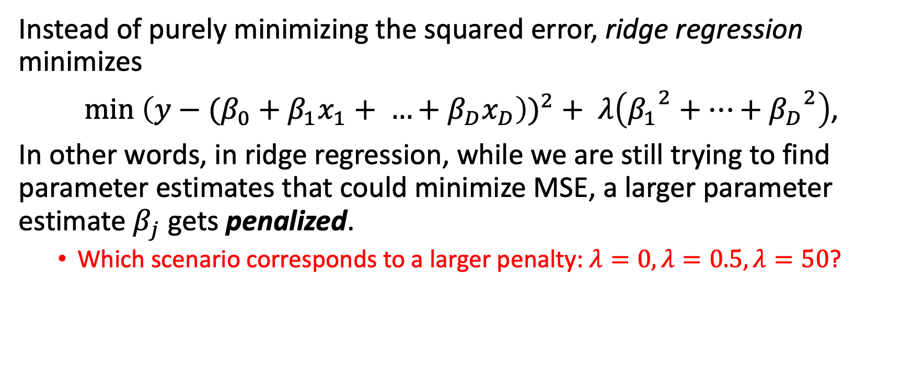
Shrinkage methods: ridge regression
Instead of purely minimizing the squared error, ridge regression minimizes
$\min{{\left(y−{(β_{0}+β}_{1}x_{1}+ …+β_{D}x_{D}\right))}^{2}+ λ\left({β_{1}}^{2}+…+{β_{D}}^{2}\right)}$,
In other words, in ridge regression, while we are still trying to find parameter estimates that could minimize MSE, a larger parameter estimate $β_{j}$ gets penalized.
Which scenario corresponds to a larger penalty: $λ=0,λ=0.5,λ=50$?

Slide 43
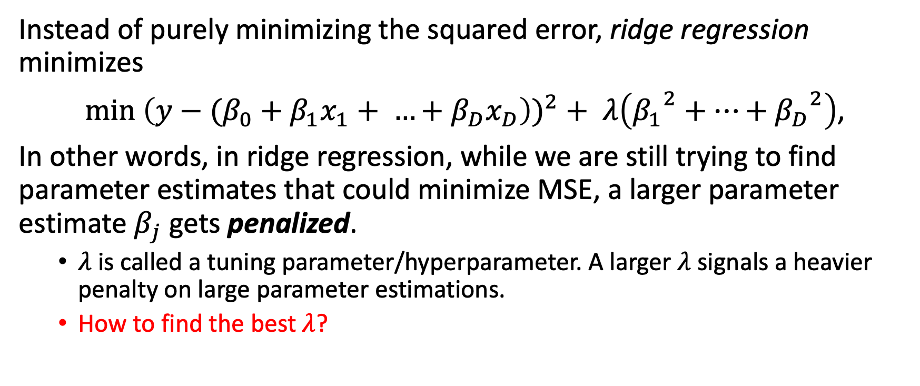
Shrinkage methods: ridge regression
Instead of purely minimizing the squared error, ridge regression minimizes
$\min{{\left(y−{(β_{0}+β}_{1}x_{1}+ …+β_{D}x_{D}\right))}^{2}+ λ\left({β_{1}}^{2}+…+{β_{D}}^{2}\right)}$,
In other words, in ridge regression, while we are still trying to find parameter estimates that could minimize MSE, a larger parameter estimate $β_{j}$ gets penalized.
$λ$ is called a tuning parameter/hyperparameter. A larger $λ$ signals a heavier penalty on large parameter estimations.
How to find the best$λ$?

Slide 44
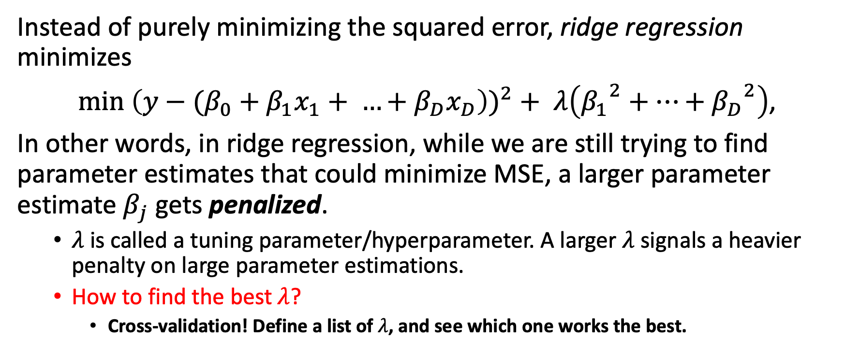
Shrinkage methods: ridge regression
Instead of purely minimizing the squared error, ridge regression minimizes
$\min{{\left(y−{(β_{0}+β}_{1}x_{1}+ …+β_{D}x_{D}\right))}^{2}+ λ\left({β_{1}}^{2}+…+{β_{D}}^{2}\right)}$,
In other words, in ridge regression, while we are still trying to find parameter estimates that could minimize MSE, a larger parameter estimate $β_{j}$ gets penalized.
$λ$ is called a tuning parameter/hyperparameter. A larger $λ$ signals a heavier penalty on large parameter estimations.
How to find the best$λ$?
Cross-validation! Define a list of$λ$, and see which one works the best.

Slide 45

Shrinkage methods: Lasso
Similar to Ridge regression, the Lasso has the following loss + penalty objective function:
$$\min{{\left(y−{(β_{0}+β}_{1}x_{1}+ …+β_{D}x_{D}\right))}^{2}+ λ\left(|β_{1}|+…+|β_{D}|\right)}.$$
We are still trying to penalize large parameter estimates, but what is the difference?

Slide 46
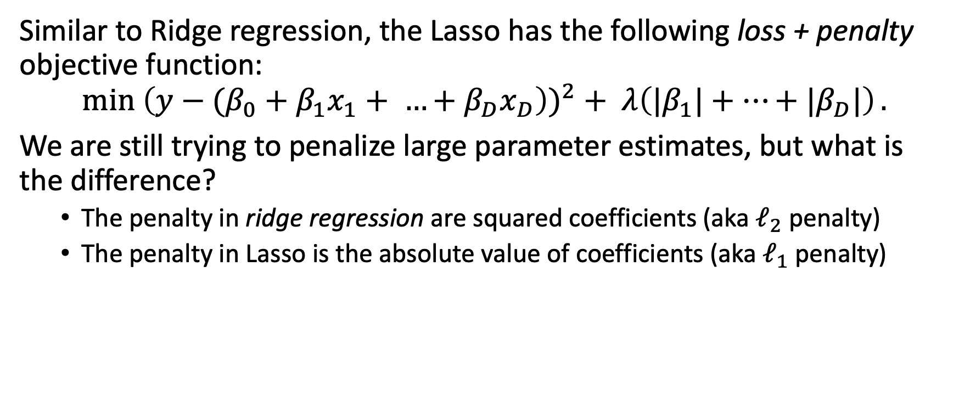
Shrinkage methods: Lasso
Similar to Ridge regression, the Lasso has the following loss + penalty objective function:
$$\min{{\left(y−{(β_{0}+β}_{1}x_{1}+ …+β_{D}x_{D}\right))}^{2}+ λ\left(|β_{1}|+…+|β_{D}|\right)}.$$
We are still trying to penalize large parameter estimates, but what is the difference?
The penalty in ridge regression are squared coefficients (aka $ℓ_{2}$ penalty)
The penalty in Lasso is the absolute value of coefficients (aka $ℓ_{1}$ penalty)

Slide 47
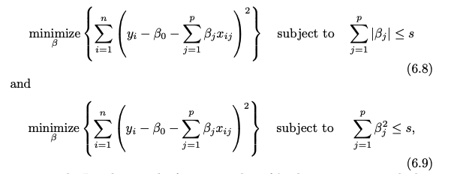
But practically, what is the difference between Ridge and Lasso?
Let’s rewrite the objective function for both:

Slide 48
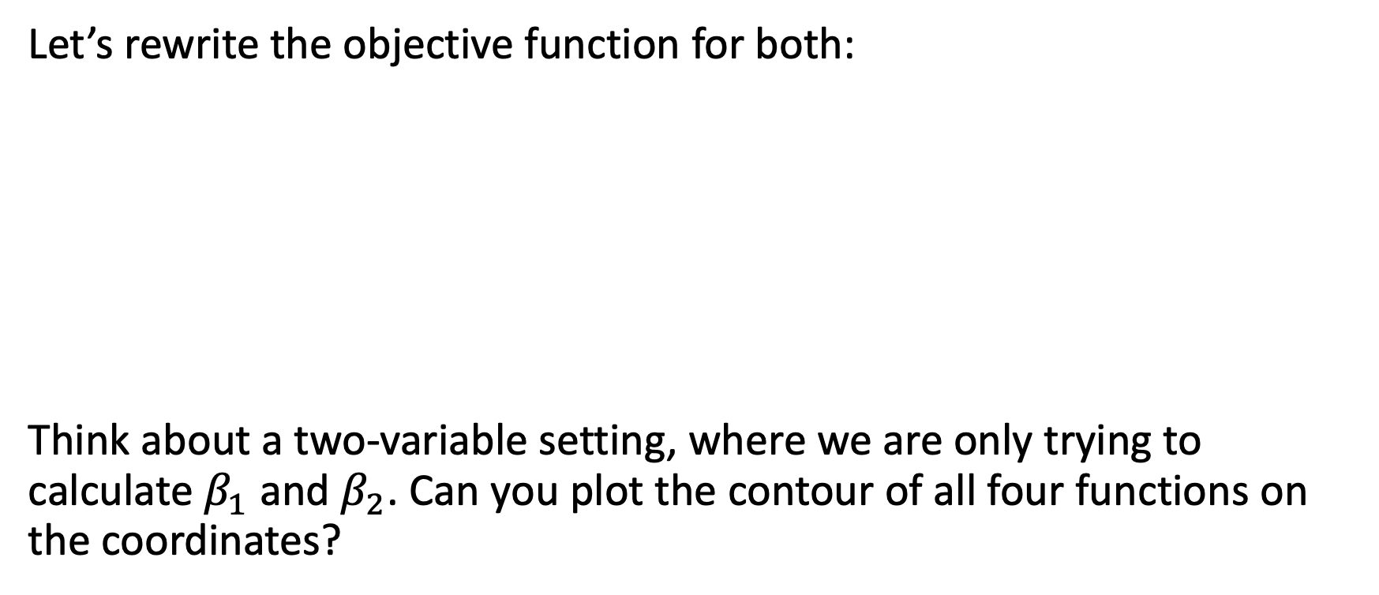
But practically, what is the difference between Ridge and Lasso?
Let’s rewrite the objective function for both:
Think about a two-variable setting, where we are only trying to calculate $β_{1}$ and $β_{2}$. Can you plot the contour of all four functions on the coordinates?

Slide 49
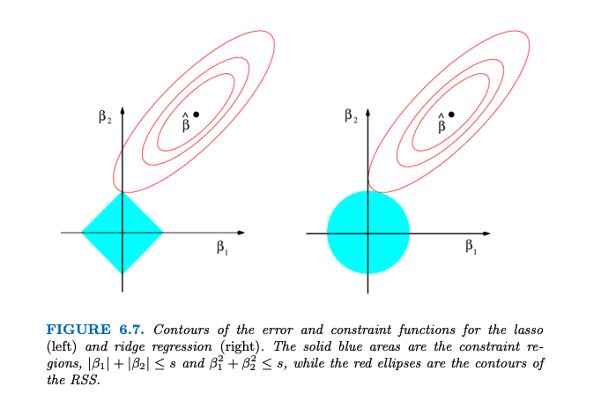
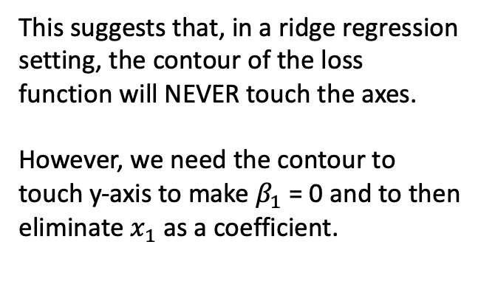
Comparing Ridge regression and the Lasso: a two-variable setting
This suggests that, in a ridge regression setting, the contour of the loss function will NEVER touch the axes.
However, we need the contour to touch y-axis to make $β_{1}$ = 0 and to then eliminate $x_{1}$ as a coefficient.

Slide 50
But practically, what is the difference between Ridge and Lasso?
Let’s rewrite the objective function for both:
Therefore, practically, the parameter estimates could be really small in Ridge, but they will NEVER be 0. (why is it annoying?)
Whereas in Lasso, some parameters could obtain an estimate of 0, and the corresponding variables could thus get eliminated from the model.

